Slide 1

Infinity War Text Game
IT 140: Module 5 – Project One
Brandon S. Luellen
IT – 140 Introduction to Scripting
Jessica Schwartz
July 30, 2022

Slide 2
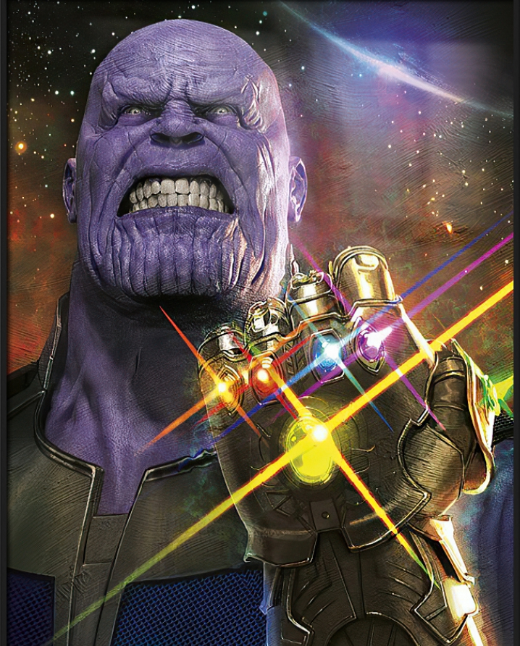
Game Description
Thanos has discovered the existence of all Infinity Stones and is trying to collect them to destroy half of the galaxy’s population. You haven’t much time to collect them for yourself and destroy the Mad Titan once and for all. There are six stones scattered through a celestial maze. The mind stone will unlock great wisdom and mental fortitude, this is in the room of mental madness. The reality stone will allow you to manipulate reality however you see fit, this is in the room of intangibility. The soul stone can harness the essence of any being, this is in the room of deep thought. The power stone grants ultimate power and strength, this is in the room of immovable objects. The space stone can teleport its user across great distances, this is in the room of invisible matter. The time stone is the sixth and final stone, this can allow its wielder to traverse time deep into the past and infinitely into the future, this is in the room of constant rewind. Gather all these stones and you will have enough power to take down the mighty Thanos!

Slide 3
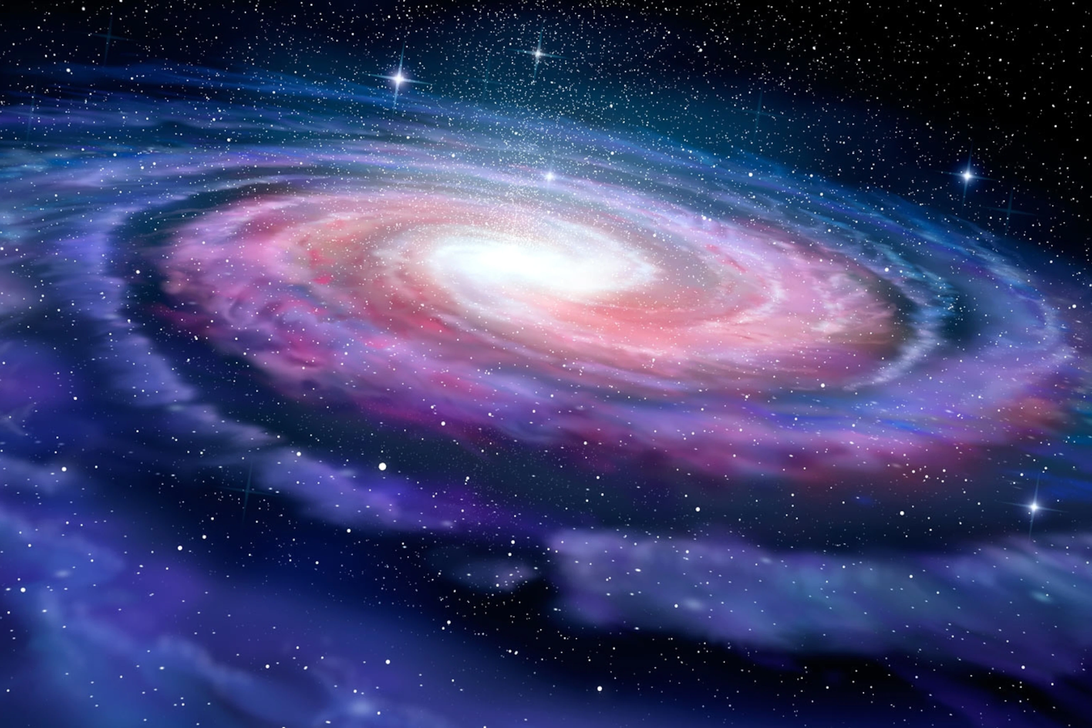
The Map
Room of Intangibility
Room of Deep Thought
Item: Reality Stone
Item: Soul Stone
Planet Titan
Thanos!
Room of Invisible Matter
The TVA
Item: Space Stone
Room of Immovable Objects
Key:
East
West
North
South
Item: Power Stone
Room of Mental Madness
Room of constant Rewind
Item: Mind Stone
Item: Time Stone

Slide 4
The pseudocode will be split into different parts for readability. The first part will start with introducing the game to the player and letting them know the commands.
Greet the player, “Welcome to the Infinity War Text Game! The Mad Titan Thanos is out searching for the Infinity Stones. Your goal is to locate all six Infinity Stones before encountering Thanos. If you encounter him before locating all the stones, then the game is over.”
Explain the available commands, while in a room you may choose to move NORTH, SOUTH, EAST, or WEST. If there is an item in your room, you can retrieve it by saying, get “item name”.
Tracking player location, the player will start in The TVA. From this location there are four possible choices that the player can make resulting in a new location. North, this brings the player into the Room of Intangibility. South, this brings the player into the Room of Mental Madness. East, this brings the player into the Room of Immovable Objects. And West, this brings the player into the Room of Invisible Matter. Each room will have different options that if selected will result in a new room being entered or the player will be told that the direction is not an option.
Getting an item, when the player enters a room that contains an object, that object will be told to them. If the player decides to get that object it will be added to their inventory list. Once the player has a list of 6 items, they can encounter Thanos and win the game. If the player has less than 6 items when they encounter Thanos, then they lose the game.
Winning the game, once the player has collected all 6 items, they will need to navigate to Planet Titan where they will find Thanos. Once this room is entered and the player has all 6 items, they have won the game.

Slide 5
Greeting the player
Ask player for their name and set this equal to player name
Greet player with, “Welcome {player name} to the Infinity War Text Game! The Mad Titan Thanos is out searching for the Infinity Stones. Your goal is to locate all six Infinity Stones before encountering Thanos. If you encounter him before locating all the stones, then the game is over.”
Tell the player that they are currently located in The TVA and explain the list of available commands.

Slide 6
Tracking player position
Get input from player to determine where their character is going to travel to. Set this equal to current location.
After completing everything in a room, prompt the player for another input to determine where they will end up next and update their current location.

Slide 7
Getting an item
Create an empty list that will be used to store any items collected by the player.
If the player enters a room that contains an item, make them aware of this item.
If the player decides to get the item, add the item to their inventory and then advise the player of their updated inventory.
Once the players inventory contains all available items, let them know that all items have been collected.

Slide 8
Losing/Winning the game
If the player enters Planet Titan anytime before their inventory is at six, let them know that they have lost the game.
Once the player’s inventory reaches six, they will be told that they have collected all the items. If they reach Planet Titan after obtaining all six items, let them know they have won the game.

